Slide 1
Extracting Latent Attributes from Video Scenes Using Text as Background Knowledge
Anh Tran, Mihai Surdeanu, Paul Cohen
University of Arizona
Third Joint Conference on Lexical and Computational Semantics (*SEM 2014)
Notes:
Hello and welcome everyone! My name is Anh Tran from the University of Arizona.
I will be presenting our paper on “Extracting Latent Attributes from Video Scenes…”
Now as far as we know, the task being proposed here is novel, so I will try my best to clearly define the problem and its significant.

Slide 2





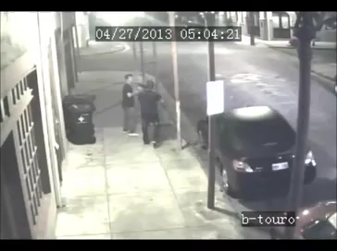
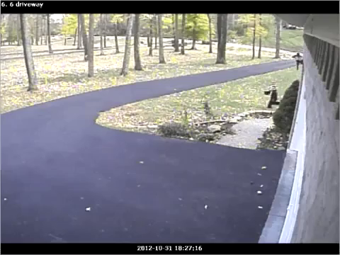
Motivation: Surveillance Application
Two chase scenarios: Should the police be notified?
A surveillance system could automatically dispatch the police if it can identify that someone is in a state of distress.
Need latent attributes (e.g., mental state information) about the scene
dark
gun
angry / fear / distress
light
no-gun
joyful / happy
Notes:
But first, let us motivate the idea with the following real-world application in video surveillance.
Consider a hypothetical surveillance system that can automatically dispatch the police in dangerous situations. It is not difficult to see how such a system could greatly improve our safety.
For example, here we have two different surveillance videos, each showing a chase scenario. And the question to ask is whether or not the police should be notified. So what do you think?
I think we can all agree that the police should be notified in the first video, but not the second.
But how did we come to that decision? What information about the video did we use?
-
-> Is it because it’s dark outside in the video? Maybe...
-
-> Or is it the presence of a gun perhaps? Likely, but not always. For example, it could have easily been a water gun. And given the low resolution of most surveillance cameras, a lot of small objects can look like a gun, so this information alone is not quite reliable.
-
-> So by themselves, these observable cues are not as informative. But together, they can help us infer the most telling sign about the video: The fact that someone is in a state of distress or danger.
-
So to make a similar decision, an automatic system will also need to be able to identify the same type of information. Unfortunately, unlike observable cues like darkness and gun, information such as the mental states of actors are often latent, which means they cannot be directly observed from the video.
And we firmly believe that the identification of these latent attributes is necessary for total video scene understanding.

Slide 3
Problem Definition
Identifying latent attributes from video scenes, with a focus on the mental states of activity participants, given some contextual information about the scenes.
Latent attributes: unobservable elements about the scene.
Mental states, motives, intentions, etc.
Contextual knowledge: any observable elements (or cues).
Activity, object, actor type (child vs. policeman)
Automatic identification of latent attributes is a challenging task.
No access to the same background knowledge that humans possess.
Can only “see” observable information (a.k.a. the contextual knowledge).
How to identify latent information based on observable cues?
Notes:
This leads us to the main problem addressed in this talk. Which to identify latent attributes from video scenes given some contextual knowledge about the scene. In particular, we will focus on identifying the mental states of activity participants.
Here, we define latent attributes as any elements about the scene that cannot be directly observed or extracted, while the contextual knowledge can be any observable cues about the scene.
-
The automatic identification of these latent attributes is not trivial. It is a very challenging task as machines do not have access to the same knowledge that humans do. A machine does not know the most basic of common sense. It doesn’t know that a smile typically means happy. All a machine knows is what it was told, e.g., that there is a chase happening and it might involve a policeman.
So how would it go about inferring these latent attributes based on these observable cues?

Slide 4
The Approach
Attributes that are latent in videos are often explicit in text.
Use explicit visual cues of videos to query large corpora, and from the resulting texts extract attributes that are latent in the videos, such as mental states.
Text Corpora
Information
Extraction
System
Video
Detectors
Detections
Mental States
Notes:
Our approach to the problem is based on one key observation: “Attributes that are latent in videos are often explicit in text.”
-
This suggests a novel method for inferring latent attributes:
The diagram here shows our proposed approach. The gray box outlines the scope of our system. Our system takes visual cues from a video as input, such as detection labels about the videos, and then uses that as contextual information to query large text corpora;
And from the resulting texts, extract attributes that are latent in the video, such as the mental state labels associated with the scene.

Slide 5
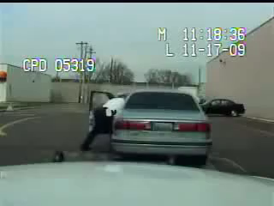
Run-through Example – Video
Text Corpora
Information
Extraction
System
Video
Detectors
Detections
Mental States
Notes:
Here is a quick run-through example.
Given a video, such as this one, we first need to process it to extract observable visual cues about the video.
These cues can come from many sources. The most intuitive of which would be from computer vision based detection algorithms.

Slide 6
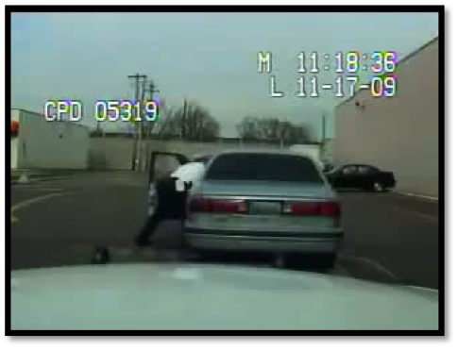
Run-through Example – Detection Labels
chase
run
...
policeman
person
...
car
Text Corpora
Information
Extraction
System
Video
Detectors
Detections
Mental States
Notes:
From these detection algorithms, we can retrieve a list of detection labels that apply to the video.
The labels can describe things like the types of object in the scene, and the activities happening in the scene.
This list ultimately serves as the contextual knowledge about the scene and is given as the input into our information extraction system.

Slide 7
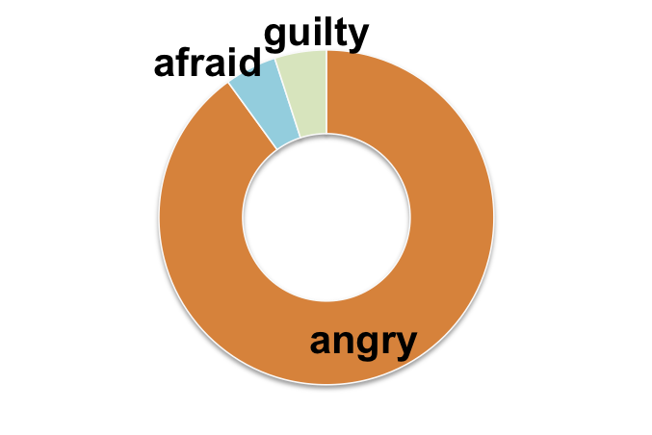
Run-through Example – Mental States
chase
run
...
policeman
person
...
car
Text Corpora
Information
Extraction
System
Video
Detectors
Detections
Mental States
Notes:
Our system then uses large text corpora to extract mental state labels associated with the input detections.
Specifically, our system produces a distribution over mental state labels as the output, such as this one.

Slide 8
Data Sources
Use MTurk workers…
As proxy for automatic detection system
To collect ground-truth mental state descriptions
Use English Gigaword 5th edition corpus
Comprehensive archive of newswire articles
26 GB in size
Contains 9,876,086 documents, over 4B words
Text Corpora
Text Corpora
Information
Extraction
System
Video
Detectors
MTurk Workers
Detections
Detection Annotation
Mental State Annotation
?
Mental States
=
Notes:
To avoid the daunting task of building a fully functional computer vision detection system, however, we decided to rely on Amazon Mechanical Turks to collect detection information for each video.
-
In essence, we used the MTurk workers as a proxy for an automatic detection system that operates at human-level performance. For each video, we asked the workers to select, from a predefined list of tags, things that apply to the video. We take care to use only tags that can be reasonably expected from existing detection algorithms.
We then use these annotated tags as the detections input for our system.
-
Additionally, we also collected the mental state label descriptions about each participating actor. We asked 10 different workers to annotate each video and aggregated their answers to create a frequency distribution of mental state labels for each video. It is important to note here that we did not restrict the vocabulary of the workers in any way. They were free to use any mental state term.
We use this data as the ground-truth mental state descriptions for evaluation purposes.
-
Moreover, asides from detections, our system also needs text corpora to query information from.
In our experiments, we chose to use the English Gigaword 5th edition corpus, which is a comprehensive archive of newswire articles. Though, one could use any other corpora here, such as the world wide web.

Slide 9

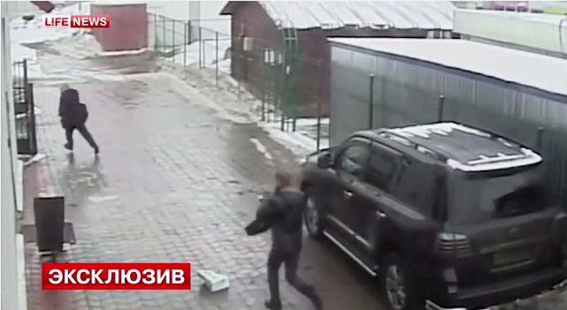
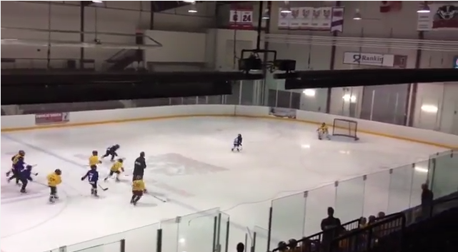
Video Dataset
Generated a dataset of 26 chase videos:
Mixture of police (5), children (7), sport-related (4), and other (12) chases.
Notes:
To test our system, we chose to focus on chase videos. Chases often invoke clear mental state inferences in humans, which makes it a good test candidate.
We generated a new video dataset by collecting videos on the Web. We found a total of 26 different videos with varying chase scenarios.

Slide 10
Detailed System Overview
System
Seed Set of Mental State Labels
Information
Extraction
Model
Detections
Query Formatter
Query Tuples
Mental State
Distribution
chase
run
...
child
policeman
person
...
(activity, actor-type)
----------------------
(chase, policeman)
(chase, officer)
(chase, child)
...
P
violent
fearful
energetic
annoyed
sad
...
angry
irate
Notes:
We will now go into more details about our proposed information extraction models.
-
Here is a detailed system diagram. Recall that given a video, the known contextual information comes into the system as a list of detection labels, or tags.
These detections are then parsed into tuples of detections by their types – we refer to these as query tuples. Query tuples follow specific typing patterns, such as an (activity, actor-type) pattern. One could use any type of patterns involving any amount of context from the input detections, but we found that our system can perform quite well given just the activity and actor-type.
The important thing that I want to emphasize in this diagram, is the Information Extraction Model box. This is what we will be talking about next. I will present several different models for implementing this box. They all differ in implementation. But the most important thing to note is that they all try to achieve the same thing.
They all take query tuples as input, and output a distribution over mental state labels. where the list of mental state labels to form a distribution over, is given by a seed set of mental state terms.

Slide 11
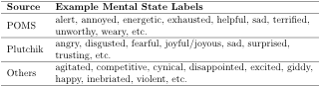
Seed Set of Mental State Labels
System
Seed Set of Mental State Labels
Seed Set of Mental State Labels
Information
Extraction
Model
Detections
Query Formatter
Query Tuples
Mental State
Distribution
P
violent
fearful
energetic
annoyed
sad
...
angry
irate
160 labels total
Notes:
This seed set, which is simply a list of common mental state labels, tells the models what mental state labels to search for during the extraction phrase, and ultimately what labels to build a distribution over.
We generated this seed set by taking mental and emotional states from popular dictionaries, such as the Profile of Mood States psychological test, and Plutchik’s wheel of emotions.
For our experiments, we used a seed set containing 160 labels

Slide 12
Neighborhood Models
System
Seed Set of Mental State Labels
Information
Extraction
Model
Detections
Query Formatter
Query Tuples
Mental State
Distribution
Three largely unsupervised information extraction models.
P
violent
fearful
energetic
annoyed
sad
...
angry
irate
Notes:
I will now discuss 3 different ways for implementing this information extraction model.

Slide 13
Vector Space with Back-off Linear Interpolation
Idea: Project mental state labels and search context into latent conceptual space produced by a RNNLM (Mikolov et al., 2013a).
Compare in latent space using the angle between the vectors.
Recurrent Neural Network Language Model
mad
v_{mad} = [0.4, 0.9, …, 0.8]
angry
v_{angry} = [0.1, 0.6, …, 0.2]
v_{mad}
v_{mad}
v_{angry}
Latent space (2D)
θ
θ
v_{sad}
Notes:
The first is a lexical semantic model that we called the vector model.
The main idea is to train a recurrent neural network language model on the Gigaword corpus, and then using the trained network to map words into a 600-dimensional latent vector space.
-
This projection allows us to compare word similarities by comparing the vector representations of these words in this latent space, where similarity is measured as the angle between the vectors. For example, consider a simple 2D space, where words are mapped to 2-dimensional vectors. Then we would expect the angle between the vectors for mad and angry to be small, while the angle between mad and sad should be much bigger.

Slide 14
Vector Space with Back-off Linear Interpolation
Idea: Project mental state labels and search context into latent conceptual space produced by a RNNLM (Mikolov et al., 2013a).
Compare mental state labels to query tuple in latent space.
Recurrent Neural Network Language Model
mad
v_{mad} = [0.4, 0.9, …, 0.8]
angry
v_{angry} = [0.1, 0.6, …, 0.2]
v_{(chase, policeman)}
v_{(chase, policeman)}
v_{angry}
Latent space (2D)
θ
θ
v_{sad}
Notes:
We can apply the same general idea to our problem.
Suppose now instead of the Vmad vector, we have a context-vector that represents the query tuple (chase, policeman).
Thus, we can compute the similarity between this context-vector to each of the mental state label in our seed set, and generate a distribution over mental state labels based on these scores.

Slide 15
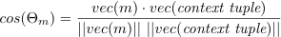
Vector Space with Back-off Linear Interpolation
Compute context-vector for query tuple:
Compute similarity to each mental state m:
→ 160 scores per context (or query) tuple.
Normalize scores to generate a distribution per tuple, average across tuples to create one distribution, and prune to yield final response distribution.
Improve robustness with back-off model (see paper for details)
v_{(chase, policeman)}
v_{m}
θ
Notes:
To compute a context-vector for a query tuple, we simply aggregate the vectors of the search terms.
And we compute the similarity between the context-vector to each mental state label m from the seed set using the cosine similarity.
-
This generates 160 different similarity scores, one per mental state label from our seed set. By normalizing this list of sores, we come up with a single distribution of mental state labels for each query tuple. We simply average across all query tuples to come up with one distribution for the video.
Lastly, we also prune this distribution before outputting it.
-
To further improve robustness, we introduce a back-off search strategy. Further details of how this is done can be found in our paper.

Slide 16
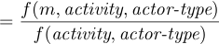
Sentence Co-occurrence with Deleted Interpolation
Idea: Words in the same sentence are likely to be related.
Rank mental state labels based on the likelihood that they appear in sentences cued by query tuples.
Interested in the conditional probability:
Normally, we could compute this probability based on relative frequencies.
However, estimation is unreliable due to sparse data!
Notes:
Our 2nd model is the sentence co-occurrence model. The idea is simple: Words in the same sentence are likely to be related.
So we would like to rank mental state labels based on the likelihood that they appear in sentences cued by query tuples.
-
That is we are interested in the conditional probability that a mental state label m would occur in a sentence, given that we already observed the desired activity and actor-type in the same sentence.
-
Now normally, we can compute this probability directly using the relative frequencies from the corpus data.
Unfortunately, due to data sparsity, these frequencies are not very reliable.

Slide 17
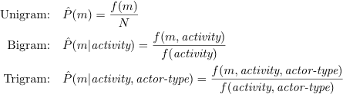
Sentence Co-occurrence with Deleted Interpolation
Cannot estimate probability of trigrams reliably from the corpus, so we estimate probability as linear interpolation of unigrams, bigrams, trigrams.
Define maximum likelihood probabilities based on relative frequencies:
N = total number of tokens in the corpus
f(m, activity) = number of sentences containing both m as an adjective and activity as a verb
Use deleted interpolation to estimate lambdas.
160 trigram probabilities for each query tuple, average across all query tuples and prune to yield final response distribution.
Notes:
So instead, we estimate the probability as a linear interpolation of unigrams, bigrams, and trigrams.
This allows us to reliably estimate the desired conditional probability.
This method gives us 160 different conditional probabilities for each query tuple, one for each mental state label in the seed set. As before, we normalize, average, and prune to yield a final response distribution.

Slide 18
Event-centric with Deleted Interpolation
Idea: Identify the event + its participants in the relevant sentences and focus only on the mental states of event participants.
A smarter, more robust, way to find collocating mental states for joint frequency estimation.
Go beyond sentence boundary.
Focus on mental states of participants.
Notes:
Our third and final model improves over the previous sentence model, by providing a smarter, more robust way to find collocating mental state labels for joint frequency estimation. We call it the event-centric model.
In particular, it addresses two limitations of the sentence model.
First, it goes beyond the single sentence boundary. We found that restricting ourselves to a single sentence was too limiting. We frequently saw joint frequency counts of 0.
Secondly, the sentence model was perhaps too lenient with its mental state extraction. It counted any mental state label that falls within the target sentence, regardless of who that mental state label references. We would like to be smarter and more selective, by focusing only on the mental state labels of event participants.
We do so by following 3 main steps.

Slide 19
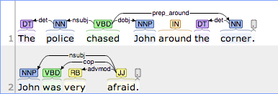
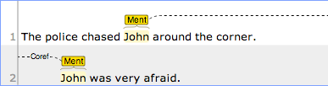
Event-centric Model
Example Output
Step 1: Participants Identification
Participants
Step 2: Corefence Resolution
Corefence Chains
Step 3:
Mental State Extraction
Mental States
Notes:
The first step in the algorithm is to identify the event and its participants from text. We do this by first identifying all sentences in the corpus where the event, for example chase, appears as a verb. Then for each verb, we use the syntactic dependency structure of the sentence to identify the nominal subject and the direct object of the verb. In this simple example, we can follow the nsubj and dobj relations to identify that the police is the subject of the verb, and John is the direct object, or the person being chased.
Once the phrases referring to the participants of interest have been found in the target sentence, we seek all other mentions of these participants by traversing the coreference chains containing the phrases extracted from step 1.
The last step extracts mental state complements from sentences in the neighborhoods that reference the participants of interest. We again do so by exploring the syntactic dependency structure of the sentence. In this example, the complement afraid is associated with the participant John via the copula verb was. Indeed afraid is also an adjective, and a mental state, so we increment the frequency count for the bigram (chase, afraid), and also the trigram (chase, policeman, afraid).

Slide 20
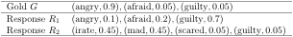
Evaluation Measure
New task → No standard performance measure
Need to compare two normalized distributions over mental state labels.
Similarity of distribution shapes (weights)
A good measure must account for the similarity between the shapes of the two distributions (i.e., ratios between weights)
Semantic similarity of distribution elements (synonyms)
A good measure must allow for semantic comparisons at the level of distribution elements (i.e., recognize that irate and angry are similar)
Notes:
As far as we know, the task we propose here is novel. As such, there is no established evaluation model for the task. So part of our research is to seek a good performance measure for the problem.
The primary evaluation task is to compare two mental state distributions. It is not a trivial task, as a good performance measure must account for 2 things.
-
The first thing it must account for is the similarity between the shapes of the distributions.
-
The second thing it must account for is the semantic similarity of distribution elements.
-
For instance, let’s look at a toy example. Here is a gold distribution G, and 2 different response distributions to be matched against G.

Slide 21
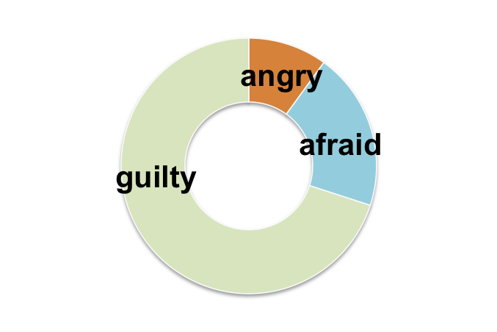
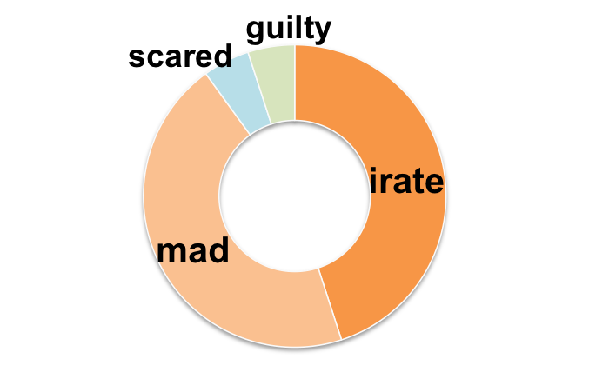
Toy Example
R₁
G
R₂
Notes:
Here is a visual representation of G.
-
And here is R1. We can see that R1 matches the terms in G perfectly, however it matches the shape, or weights, of G poorly.
-
R2 on the other hand doesn’t have an exact match for all of its terms, but does match the full meaning and shape of G, since irate and mad are similar to angry, and scared is the same as afraid.

Slide 22
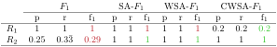
Constrained Weighted Similarity-Aligned F1
R₁
G
R₂
red = non-intuitive score
green = intuitive score
Notes:
Our research eventually led to the construction of a new performance measure, based on the simple and intuitive F1 measure. Those interested can refer to our paper for the derivation of CWSA-F1. For now, we will simply mention that it does satisfy both criteria to our problem, while also yielding intuitive results.
As opposed to F1, CWSA-F1 correctly punishes R1 for missing the shape of G, while rewarding R2 for matching both the meaning and shape of G via synonyms.

Slide 23
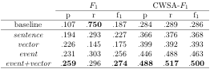
Mental State Identification in Chase Videos
The average evaluation performance across 26 different chase videos are shown against the baseline scores for our neighborhood information extraction models. Bold font indicates the best score in a given column.
* All average improvements over the baseline responses are significant (p < 0.01). All significance tests were one-tailed and were based on nonparametric bootstrap resampling with 10,000 iterations.
Notes:
So using CWSA-F1 as the primary performance measure. Here are the performance results averaged across 26 different chase videos for each model.
We compare these scores against a uniform baseline model. The baseline model is a naïve model that simply returns all 160 mental state labels from our initial seed set with uniform probability.
We have the three familiar models: vector, sentence and event model. Along with an ensemble model that combines the results of the vector model and the event model, simply by taking the average of the two response distributions.

Slide 24
Mental State Identification in Chase Videos
event+vector outperformed baseline by almost 75%.
Ensemble outperformed individual components.
Operating in latent space (vector) and operating on text (event) yield complementary information.
Incremental improvements due to NLP.
sentence is similar to current state-of-the-art (e.g., de Marneffe et al. 2010)
sentence < vector < event
Notes:
Under the CWSA-F1 performance measure, which does correctly account for both synonyms and distribution weights. The ensemble model event+vector scored best in all measured scores. It improves over the naïve baseline by almost 75%!
-
Moreover, it outperformed each of its individual component by a significant amount. Further, we found this to be true when combining any deleted interpolation model with the vector model. This strongly suggests that the information gained by operating in a latent conceptual space, and operating on text are highly complementary.
-
We also noticed a steady improvement in performance as we added more NLP techniques to focus in on the mental state of event participants. The event model significantly outperformed the shallower sentence model.
We would also like to note that our sentence model can be viewed as a strong baseline that is representative of common state-of-the-art technologies. For example, de Marneffe used similar techniques to learn the meanings of scalar adjectives by extracting children’s ages that were commonly collocated with phrases like “little kids”.
Further results can be found in our paper.

Slide 25
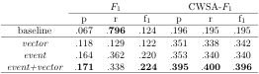
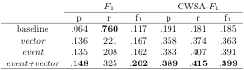
Additional Results* – Actor-specific
The average evaluation performance for the mental state of the
subject across 26 different chase videos.
The average evaluation performance for the mental state of the
object across 26 different chase videos.
* Results not included in paper
Notes:
Now, I’d like to shift gear and briefly mention additional results that were not included in the paper.
Our previous experiment focused on the activity-wide mental state identification task. That is, we return a single distribution of mental states to describe the entire activity. However, our event model is capable of differentiating between the mental states of the subject versus the object. This allows us to solve the actor-specific mental state identification task. In general, this is a harder task as it requires more specific information.
-
Here are the results averaged across 26 videos for the subject (i.e., the chaser). We see that overall the scores are a little lower, since the task is harder. The added difficulty of the task is also evidence in the much lower performance of the uniform baseline.
-
Similarly, here are the results for the object, or the person being chased. In both cases, our ensemble model performed best and significantly improved over the baseline by over 100%.
This shows that our system is definitely capable of making actor-specific mental state identification.

Slide 26
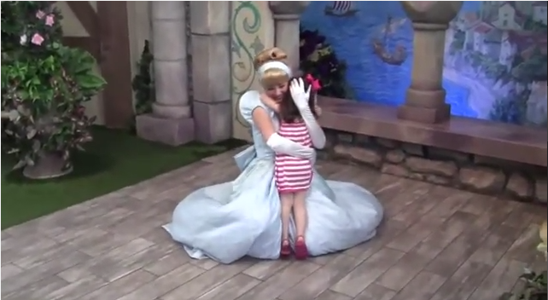
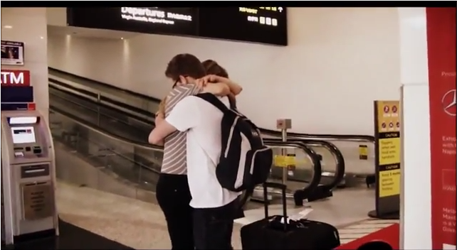
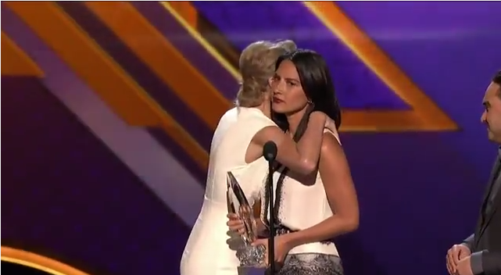
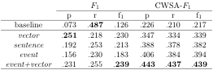
Additional Results* – Hug Dataset
Performance average across 45 hug videos
event+vector outperformed baseline by over 100%
Consistent behavior as in chase videos:
Ensemble outperformed individual components.
Incremental improvement with each NLP module.
* Results not included in paper
Notes:
To test the robustness of our models, we also evaluated our system on a different dataset.
The hug dataset contains 45 different hug videos. Hug scenarios are different than chases in that the differences in mental state distributions between each scenario is much more subtle. For example, consider a hug between two lovers versus a hug between a mom and her child.
-
Here are the results averaged across all 45 videos.
- Despite a drop in performance across all models, we note that the behavior of our system was very consistent with what happened in the chase dataset.
The ensemble model still did best overall, and still outperformed each of its individual component by a good margin.
The addition of NLP components still improved performance over the shallower sentence model.
These results show that our models are general and they work consistently well across different events.

Slide 27
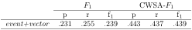
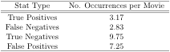
Additional Results* – Noisy Detections
Introduce noise into detections based on published precision rates of actual state-of-the-art detectors in computer vision
False-positive: randomly insert new detection label
False-negative: randomly withhold an annotated detection label
Average errors introduced per movie
Performance average across 20 different simulations (26 chase videos per simulation)
* Results not included in paper
Notes:
Lastly we evaluated the performance of our models under noisy detector conditions. We simulated the noisy nature of automatic detection algorithms by introducing noisy errors into our list of annotated detections. For this experiment, we also included location-type detections.
For each video, we introduced a false positive error by randomly inserting a new detection into the list, and a false negative error by randomly removing an annotated label. The rates at which we added errors are based on published precision rates of state-of-the-art detectors.
-
On average, we introduced over 10 different errors per movie. It’s also interesting to note that on average, the list of detections given to our system contains more wrong detections, 7.25 false positives, than correct detections, 3.17 true positives.
-
Here is the result of our ensemble model, averaged across 20 different simulations, where a simulation is ran over 26 chase videos.
As expected, the performance dropped under noisy detections. However, the CWSA-F1 score still significantly outperforms the baseline from the previous slide of .286.

Slide 28
Conclusions
Summary
Problem: Identifying latent attributes in videos, given some context.
Data: Videos from web, annotations via crowd sourcing
Solution: Largely unsupervised information extraction models
Lexical semantic in vector space (vector)
Sentence co-occurrence in text (sentence)
Event-centric in text (event)
Evaluation: CWSA-F₁ score to compare mental state distributions
Findings
First to show how to identify latent information from videos using text collections as the sole background knowledge
More NLP → better performance
Robust models: work on different datasets, tolerate noisy detections
All code (Scala) + data (annotations & videos) at
https://trananh.github.io/vlsa/
Notes:
This brings us to the conclusion. In this talk, I’ve introduced the problem of identifying latent attributes in videos, given some contextual information about the video.
I’ve presented 3 largely unsupervised information extraction models for acquiring information about latent attributes from large corpora.
We also talked about how to evaluate these models. In particular, we constructed a novel performance measure based on the classical F1 measure that accounts for both the similarity in the shapes of the distributions, and the semantic similarity between their elements.
-
As far as we know, we are the first to show how to identify latent information from videos using text collections as the sole background knowledge.
We demonstrated that the inclusion of more NLP technologies to refine the extraction process can lead to better performance.
And we showed that our models are robust. They work well across 2 different datasets, and can tolerate noisy detections.

Slide 29
The End

Slide 30
Backup Slides

Slide 31
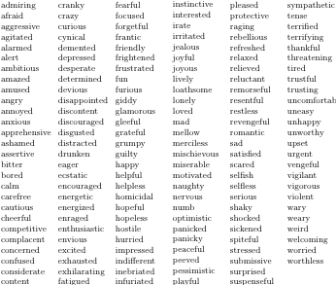
Notes:
List of 160 mental state compiled from popular mental and emotional state dictionaries, including the Profile of Mood States (McNair et al., 1971) and Plutchik’s wheel of emotions. These labels also include frequently used labels gathered from synsets found in WordNet.

Slide 32
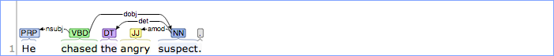
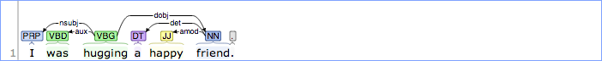
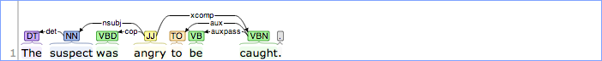
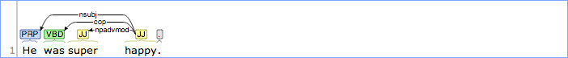
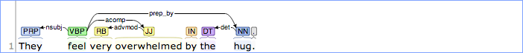
Notes:
Complements extraction patterns
- amod from subject
- nsubj + cop
- nsubj + aux
- nsbuj + acomp
- nsubj + dep

Slide 33
Notes:
Participants identification patterns
- nsubj + dobj
- dobj
- nsubjpass + agent (by)
- nsubj + prep_after (after for chase)

Slide 34
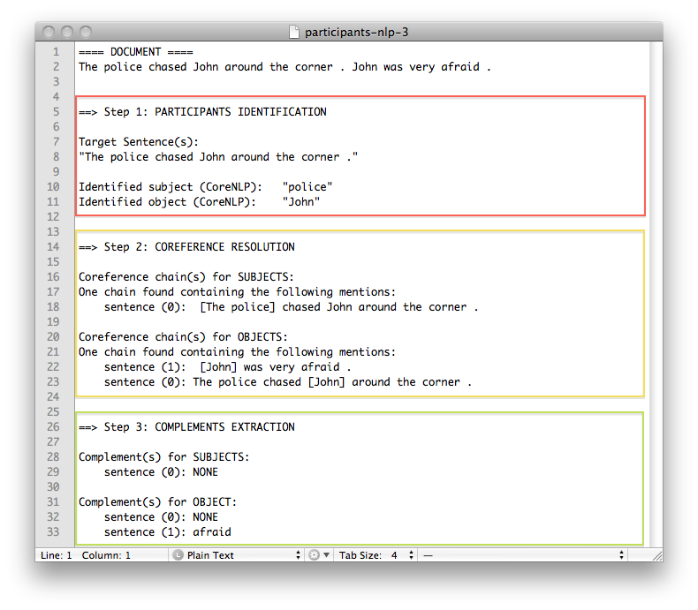
Notes:
That was a mock-up example. Here’s an actual output from our model on the same sentences.
We see that step 1 correctly identified the participants of chase.
Step 2 found the correct coreference chain for John.
And Step 3 identified the mental state complement afraid for the object John.

Slide 35
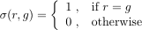
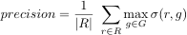
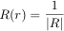
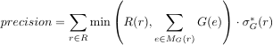
Constrained Weighted Similarity-Aligned F1
We start with the standard F₁ measure.
Generalize the formulas to address our criteria.
Address greedy problem of WSA-F₁
F₁
SA-F₁
WSA-F₁
CWSA-F₁
Notes:
Our research eventually led to the construction of a new performance measure, based on the simple and intuitive F1 measure. The standard F1 measure is defined as the harmonic mean between precision and recall. F1 does not immediately address any of our criteria so some modifications are needed. We do this by generalizing the formulas as follows.
-
The calculation of precision, which is simply the number of true positives over the size of the response set, can be generalized to the following equation. Note that the calculation of true positives is the same as comparing each element in the response set R to every element in the gold set and then returning the best (or max) match score, where the matching function is defined to return 1 for an exact match…
Clearly, this similarity function sigma can instead be defined to take on values proportional to the semantic similarity between labels r and g. This allows us to choose from a wide range of word similarity …We can similarly define recall, and also an F1 value as the harmonic mean of these new scores. We call this first formulation the Similarity-Aligned F1 score, as it accounts for the similarity between words. But it does not account for their weights.
-
Let’s generalize the equation some more by moving the division into the summation. If we define the function R to return the uniform probability 1 / |R| for all elements r in the response set, then this is the exact same equation as above. In this formulation, it is clear to see that every element is assigned a uniform weight in the standard F1. Clearly, we can simply use the distribution weight of r instead of this uniform weight. We also define this value delta * to represent the max term above. This gives us our Weighted Similarity-Aligned F1 score.
-
It would seem on the surface that WSA-F1 addresses both criteria of our problem. However, there is a flaw in that it does not account for the total weights available for rewards in the other distribution. We address this issue with the constrained weighted similarity-aligned F1 score.

Slide 36
Constrained Weighted Similarity-Aligned F1
We start with the standard F₁ measure.
Generalize the formulas to address our criteria.
Address greedy problem of WSA-F₁
F₁
?
SA-F₁
WSA-F₁
CWSA-F₁
Notes:
A simple analogy might help here, suppose we have a mystery box of color pencils that we try to match.
-
Suppose that our response box contains 10 red color pencils.
-
But the mystery box only contains only 2 red color pencils.
-
Should we be rewarded for all 10 red pencils?
-
Or should the reward be capped by the 2 red pencils available in the mystery box.
We believe the latter is more accurate.
We address this issue by adding a min term, to cap the amount of reward an element can receive. To better explain this, let’s look at our toy example from before.

Slide 37
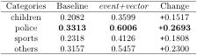
Limitation: Biases in Underlying Data
The average CWSA-F₁ scores for the ensemble model event+vector are shown in comparison to the baseline performance, categorized by video scenarios.
children = video contains a child participant
police = video contains a policeman participant
sports = video is sports-related
other = video does not fit in the first categories (e.g., civilian adults)
Notes:
It turns out that our models did not do equally well across all videos. There are videos for which we did very well on, and there are ones that are more challenging to our models.
Here, we list the average CWSA-F1 scores for the ensemble model event+vector and the baseline model, categorized by different video scenarios. The children category includes any chase videos involving a child participant; likewise for the police category; the sports category includes any sports-related videos. All other videos fall into the others category, such as videos involving normal civilian adults. Note that a video my fall into multiple categories. For example we have 2 videos of children playing sports.
*** Of these, five involve police officers, seven involve children, four show sports-related scenes, and twelve describe different chase scenarios involving civilian adults (two videos involve both children and sports scenes).

Slide 38
Limitations: Biases in Underlying Data
Baseline did worse on children and sports-related videos than police related videos.
Baseline uses all 160 mental states with uniform probability.
Initial seed set is more fit to describe police chases.
See biggest improvement over baseline on police videos, least improvement on children videos.
Gigaword corpus = newswire articles
Underlying corpus is biased towards police chases (i.e., news-worthy events).
Notes:
We noticed a few interesting trends here. The baseline method did worse on children and sports-related videos than on police related videos.
-
But remember that the baseline doesn’t do any thing smart, it simply returns all 160 mental states from our set with uniform probability. This means that our initial seed set of mental states is more fit to describe police chases than other chases. So it is biased towards police videos.
-
Moreover, we also see that the ensemble model makes the biggest improvement over the baseline method on police videos (both in terms of raw value and percentage), and makes the least improvement on children videos.
-
We think this is evidence of the information bias from the Gigaword corpus. Recall that the Gigaword corpus comprises of newswire articles, and news usually contain a very specific type of information. In particular, the news is more likely to address news-worthy events like police chases, and even sports events. It is not the place to find descriptions of happy children chases. So again, the bias in the underlying data source favors police videos.

Slide 39
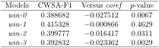
Effectiveness of Coreference Resolution
Comparing the average CWSA-F1 scores of a naïve windowing model, under different window sizes, to the performance of the coref model.
The p-values, based on the average differences, were obtained using one-tailed nonparametric bootstrap resampling with 10,000 iterations.
win-n extends the single sentence boundary of sentence to also include the n preceeding and n following sentences, while also piecing all relevant sentences of a document together to generate 1 neighborhood per document.
Notes:
Lastly, we wanted to test the importance of various NLP components to our model. As mentioned, the improvement from the event model over the coref model shows that focusing on event participants is important. We also know that using coref to expand the neighborhood area is important, but can we achieve the same result using a simple windowing method to expand the neighborhood area?
The windowing method simply extends the sentence boundary of the sentence model to include the n preceeding and n following sentences. So for win-2, we would include the 2 sentences before and 2 after each target sentence in our neighborhood. We compared the performance of coref to the windowing method with several different configurations.
Here is the average CWSA-F1 score across 26 chase videos for each window configuration.

Slide 40
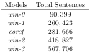
Effectiveness of Coreference Resolution
coref outperformed all tested windowing configurations.
Improvement over win-1 is not significant.
coref and win-1 generate very similar neighborhoods (extracted roughly the same number of sentences relevant to chase).
coref does not do worse + provides references to participants for downstream process.
Notes:
We see the the coref model outperformed all tested windowing configurations.
-
Except the improvement over win-1 is not significant.
Let’s think for a moment about why that is. If a piece of text is coherent and cohesive, then successive sentences are very likely to refer to the same concepts and topics. And win-1 always grabs the immediately surrounding sentences. Moreover, since newswire text tend to be short, thus win-1 is likely to generate the same neighborhood area as coref. This is reflected in this table, which shows the total number relevant sentences retrieved from the corpus by each model. We see that coref and win-1 retrieved roughly the same number of sentences relevant to chase.
-
In general, coref does not do worse than a simpler method, which is good news. This warrants the added complexity of using coref, as it also provides references to participants in each sentence for the downstream process.

Slide 41
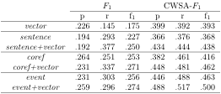
Ensemble Models
Combine a deleted interpolation model (text space) with vector model (latent space) creates an ensemble model.
Every ensemble model outperformed its respective individual components.
Information gained from operating on text and operating in the latent vector space are highly complementary.
Improvement to each will improve the resulting ensemble model.
Notes:
First we look at ensemble models.
For each deleted interpolation model, which operates on text, we combined it with the vector model, which operates in a latent conceptual space to create an ensemble model. So the combination of the sentence model and the vector model yields the sentence+vector model. And similarly for others.
We see that every single ensemble model outperformed its respective individual components, all by statistically significant margins.
-
This evidence strongly suggests that the information gained from operating on text and operating in the latent vector space are highly complementary. This means we can make improvements to each model separately, and any local improvement to the individual models will improve the resulting ensemble model.

